Slide 1
Self-Efficacy

Slide 2
What Is the Meaning of Self-Efficacy? A Definition
Self-efficacy is the belief we have in our own abilities, specifically our ability to meet the challenges ahead of us and complete a task successfully (Akhtar, 2008). General self-efficacy refers to our overall belief in our ability to succeed, but there are many more specific forms of self-efficacy as well (e.g., academic, parenting, sports).
Although self-efficacy is related to our sense of self-worth or value as a human being, there is at least one important distinction.

Slide 3
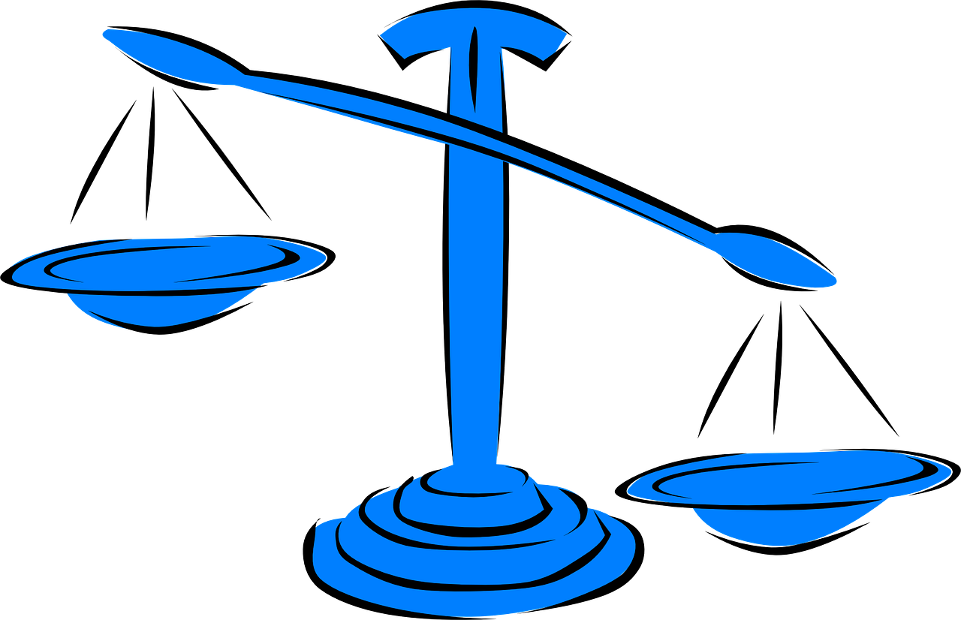
Self-efficacy vs. self-esteem
Self-esteem is conceptualized as a sort of general or overall feeling of one’s worth or value (Neill, 2005). While self-esteem is focused more on “being” (e.g., feeling that you are perfectly acceptable as you are), self-efficacy is more focused on “doing” (e.g., feeling that you are up to a challenge).
High self-worth can definitely improve one’s sense of self-efficacy, just as high self-efficacy can contribute to one’s sense of overall value or worth, but the two stand as separate constructs.

Slide 4
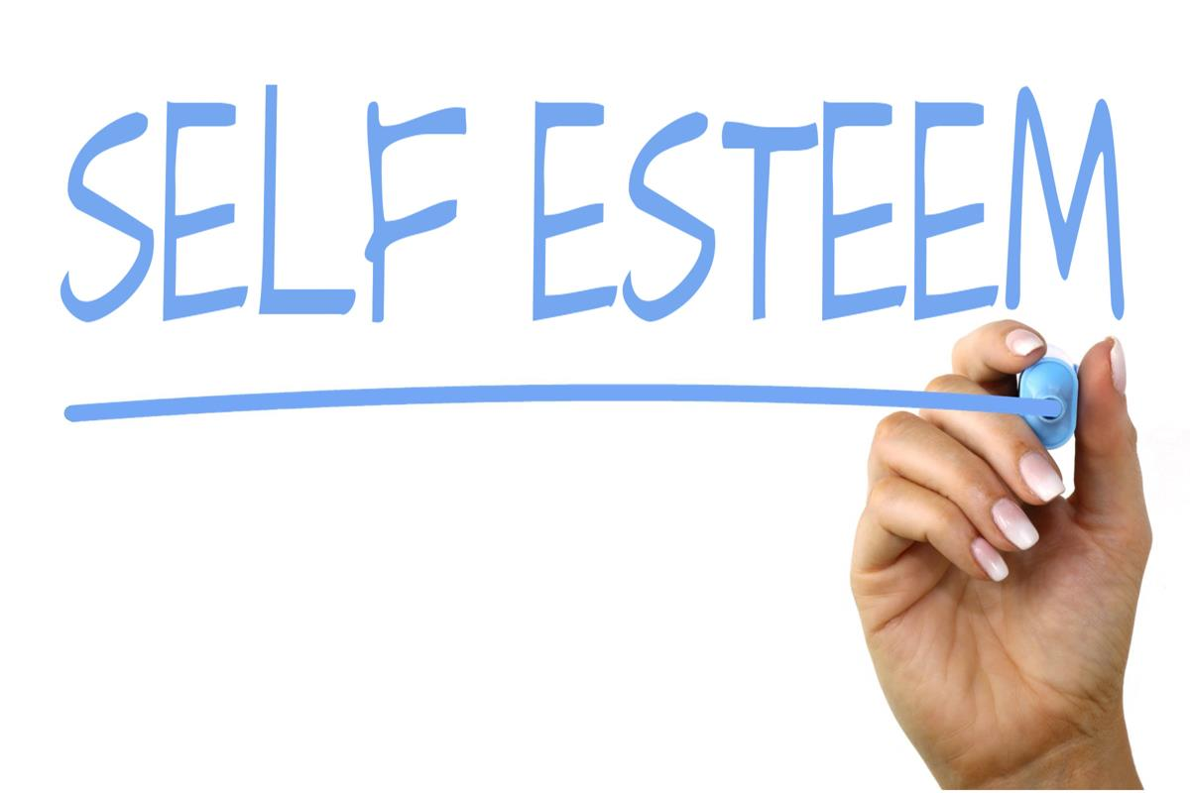
Self-efficacy vs. self-esteem
Self-esteem is conceptualized as a sort of general or overall feeling of one’s worth or value (Neill, 2005). While self-esteem is focused more on “being” (e.g., feeling that you are perfectly acceptable as you are), self-efficacy is more focused on “doing” (e.g., feeling that you are up to a challenge). High self-worth can definitely improve one’s sense of self-efficacy, just as high self-efficacy can contribute to one’s sense of overall value or worth, but the two stand as separate constructs.
To zdjęcie, autor: Nieznany autor, licencja: CC BY-SA

Slide 5
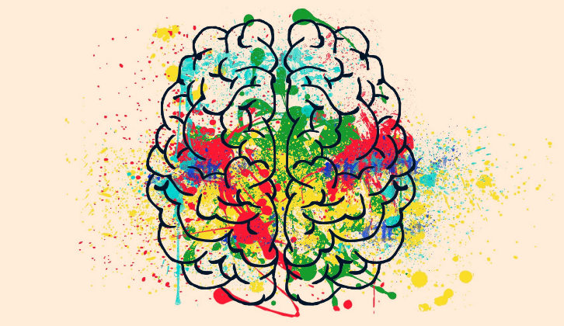
Self-efficacy and self-regulation
Since self-efficacy is related to the concept of self-control and the ability to modulate your behavior to reach your goals, it can sometimes be confused with self-regulation. They are related, but still separate concepts. Self-regulation refers to an individual’s “self-generated thoughts, feelings, and actions that are systematically designed to affect one’s learning” (Schunk & Zimmerman, 2007), while self-efficacy is a concept more closely related to an individual’s perceived abilities. In other words, self-regulation is more of a strategy for achieving one’s goals, especially in relation to learning, while self-efficacy is the belief that he or she can succeed.

Slide 6
Self-efficacy and motivation
Similarly, although self-efficacy and motivation are deeply entwined, they are also two separate constructs. Self-efficacy is based on an individual’s belief in their own capacity to achieve, while motivation is based on the individual’s desire to achieve. Those with high self-efficacy often have high motivation and vice versa, but it is not a foregone conclusion.
Still, it is true that when an individual gains or maintains self-efficacy through the experience of success—however small—they generally get a boost in motivation to continue learning and making progress (Mayer, 2010).
The relationship can also work in the other direction to create a sort of success cycle; when an individual is highly motivated to learn and succeed, they are more likely to achieve their goals, giving them an experience that contributes to their overall self-efficacy.
To zdjęcie, autor: Nieznany autor, licencja: CC BY-SA-NC

Slide 7
Self-efficacy and resilience
While experiences of success certainly make up a large portion of self-efficacy development, there is also room for failure.
Those with a high level of self-efficacy are not only more likely to succeed, but they are also more likely to bounce back and recover from failure.
This is the ability at the heart of resilience, and it is greatly impacted by self-efficacy.
To zdjęcie, autor: Nieznany autor, licencja: CC BY-SA-NC

Slide 8
5 Examples of High Self-Efficacy
So what does high self-efficacy look like?
It’s relatively easy to spot because those with high self-efficacy tend to be those who achieve, accomplish, and succeed more often than others.
High self-efficacy can manifest as one or more of the following traits and behaviors, among others:
A student who is not particularly gifted in a certain subject but believes in her own ability to learn it well;
A man who has had bad luck with relationships so far, but retains a positive outlook on his ability to connect with his upcoming date;
An expectant mother who is nervous about caring for a new baby, but believes that she has what it takes to succeed, no matter how difficult or scary it is;
A new graduate who takes a high-profile, high-status job that she has never done before, but that she feels she can succeed in;
An entrepreneur who pours his heart and soul into establishing his business, but quickly moves on to his next great idea when his business is hit with an insurmountable and unexpected challenge.
To zdjęcie, autor: Nieznany autor, licencja: CC BY-SA

Slide 9
Why self-efficacy matters – Mamie Morrow
https://www.youtube.com/watch?v=agwsjYg9hJ8&t=31s

Slide 10
Can We Test and Survey Self-Efficacy?
Self-efficacy can indeed be measured.
It is prone to the same sorts of issues as all self-report measures of a somewhat abstract construct, but there are still several methodologically sound ways to go about it.
Some researchers suggest making your scale specific to the type of self-efficacy you want to study; for example, if you are interested in academic self-efficacy, ask about academic pursuits and confidence.
There are some scales available for measuring specific types of self-efficacy, but it is also possible to (carefully!) adapt the general scales to better narrow in on your construct of interest.

Slide 11
Measuring self-efficacy with scales and questionnaires (PDF)
There are several scales and questionnaires you can use to measure general self-efficacy. Three of the most popular are described below.
General/Generalized Self-Efficacy Scale (GSE)
The General Self-Efficacy Scale may be the most popular self-efficacy scale. It has been in use since 1995 and has been cited in hundreds of articles. It was developed by researchers Schwarzer and Jerusalem, two leading experts in self-efficacy.
The scale consists of 10 items rated on a scale from 1 (Not true at all) to 4 (Exactly true). These items are as follows:
I can always manage to solve difficult problems if I try hard enough;
If someone opposes me, I can find the means and ways to get what I want;
It is easy for me to stick to my aims and accomplish my goals;
I am confident that I could deal efficiently with unexpected events;
Thanks to my resourcefulness, I know how to handle unforeseen situations;
I can solve most problems if I invest the necessary effort;
I can remain calm when facing difficulties because I can rely on my coping abilities;
When I am confronted with a problem, I can usually find several solutions;
If I am in trouble, I can usually think of a solution;
I can usually handle whatever comes my way.
The score is calculated by adding up the response to each item. The total will be between 10 and 40, with higher scores indicating higher self-efficacy.
The scale has proven to be reliable and valid in multiple contexts and cultures.
To use this scale, click here.

Slide 12
Self-efficacy in learning and education
Self-efficacy has probably been most studied within the context of the classroom. There is a good reason for this, as self-efficacy is like many other traits and skills—best developed early to reap the full benefits.
Much attention has been paid to how teachers can most effectively boost their students’ self-efficacy and help them to learn, work, play, and communicate with others in a healthy and productive way.
It turns out that one of the best ways to enhance self-efficacy in those you teach or lead is to first ensure that you have a healthy sense of self-efficacy!

